Slide 1

Analysis of the SQL Injection
By: Daniela Gonzalez and Kyle Mejia

Slide 2
SQL INJECTION INTRODUCTION
Injection of malicious SQL statements into the code of websites and web apps to hijack back-end processes and access, extract, and delete confidential information from your databases.
First documented in 1998
Within recent years, 65.1% of all attacks on software applications were SQL injections alone
OWASP Top 10 for 2021, ranked number 3 under 'Injection'

Slide 3
Lab configurations
Ubuntu server 20.0.4 with DVWA
Filebeat to use for Elasticsearch
curl -L -O https://artifacts.elastic.co/downloads/beats/filebeat/filebeat-8.1.3-amd64.deb sudo dpkg -i filebeat-8.1.3-amd64.deb
Filebeat modules enable nginx
Filebeat setup –e
Sudo service filebeat start

Slide 4
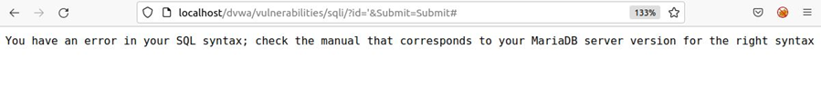
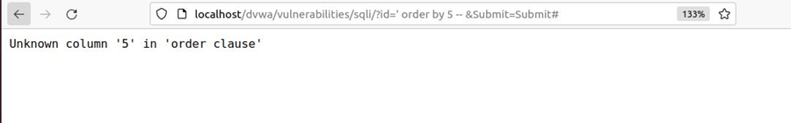
Error-based sql injection
Error-based SQL injections rely on error messages thrown by the database server to obtain information about the structure of the database.
Error: You have an error in your SQL syntax, check the manual that corresponds to your MySQL server version for the right syntax to use near “%” at line 1.
A query of ‘ ORDER BY 5 -- was inserted into the URL. The output generated an error message that indicated there were less than 5 tables within this database.

Slide 5
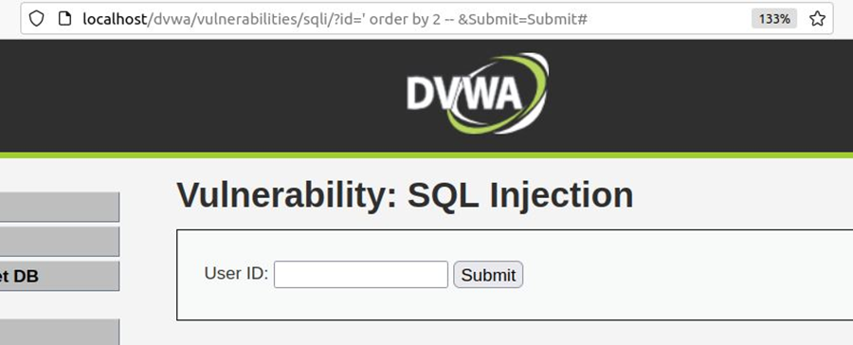
Error–based continued
Output when the query of ‘ ORDER BY 2 – was input. Instead of an error message being outputted, a proper web page was formed from the SQL query. This indicates that the database contains 2 tables.
Through a process of trial and error, our group successfully determined the number of tables present within a database by observing error messages.

Slide 6
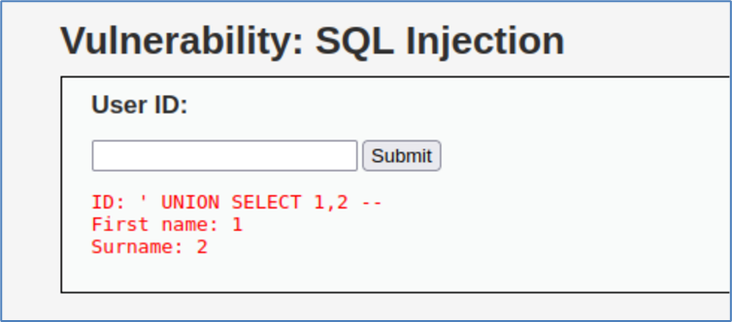
Union-based sql injection
Union-based SQL injection is an in-band SQL injection technique that leverages the UNION SQL operator. This is used to combine the results of two or more SELECT statements into a single result; that result is then returned as part of the HTTP response.
The image shows how using a UNION statement to perform SQL injection into a database can lead to the compromise of confidential information.

Slide 7
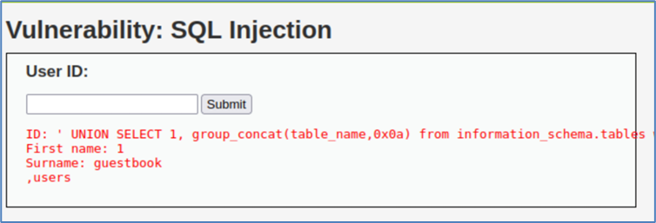
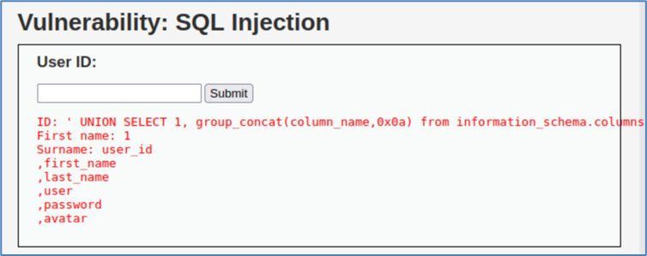
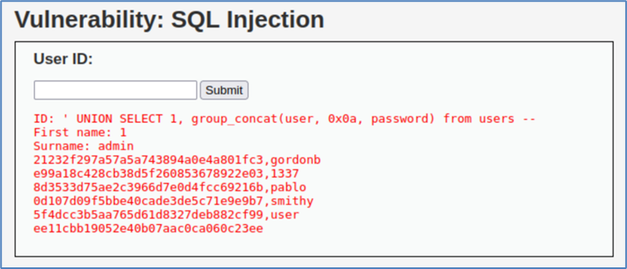
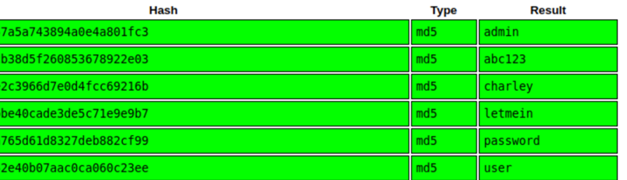
Union-based continued
This shows the results of a Union-based SQL injection that retrieves both “First name” and “Surname”. The injection was inserted through the URL.
This shows all the column names. With this, useful fields such as first name, last name, user, password, and avatar are retrieved. This leads to gaining all the information on users.
Shows all the usernames and their respected passwords in hashed form collected.
Displays the hashes with their passwords shown in plaintext

Slide 8
BLIND SQL INJECTION
Error messages or SQL query results are not made directly visible
Attackers must make discernments through responses of web server
Using true or false questions

Slide 9
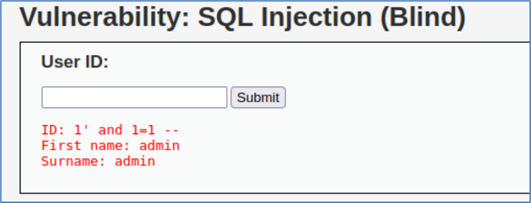
BOOLEAN-BASED sql injection
Blind SQL Injection attack that presents the database with true or false questions.
Based on the response of the application, answers can be determined by the attack to gain a greater understanding of the database’s layouts and confidential data.
We can inject a query with a true condition (1=1). If the content of the page is different than the page that returned during false condition(1=2), then we can assume that SQL injection is working.
Shows a true statement of “1=1” in the SQL statement. This allows the database to infer the statement as true and displays both the first name and surname fields of the database.

Slide 10
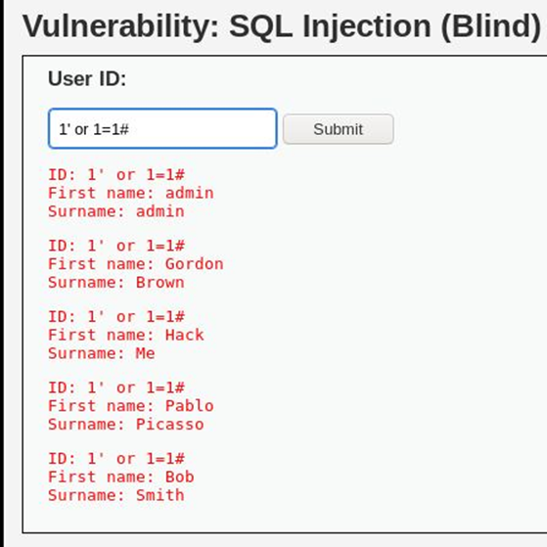
BOOLEAN-BASED SQL Injection continued
Shows a # character added to this injection. This comments the query coming after the character and effectively displays all users of the database.

Slide 11
Time-based sql injection
Blind SQL Injection technique that relies on sending an SQL query to the database which forces the database to wait for a specified amount of time in seconds before responding.
Whether a delay occurs or not for results to output, the attack can infer whether statements inserted are true or false. This is a slow but effective process so that valuable information may be extracted
SLEEP is a common SQL command used to specify a wait period before executing results. It is often exploited by attackers for the purpose of time-base SQL injection.

Slide 12
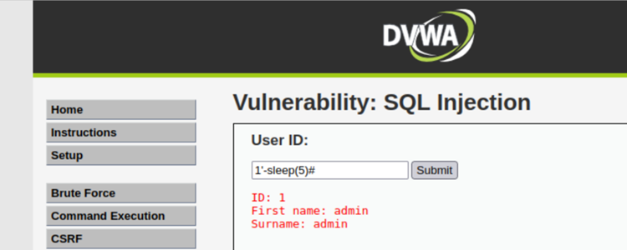
Time-based sql injection continued
Displays a SLEEP query that tells the database to wait
5 seconds before fulfilling the query.

Slide 13
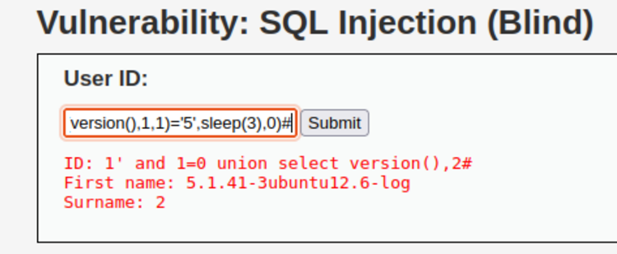
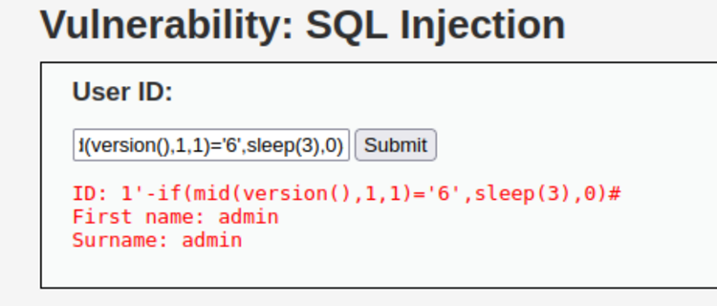
TIME-BASED SQL INJECTION CONTINUED
Displays the query that retrieved the database version of 5.1.41-3ubuntu12.6. This would be used to execute true or false questions.
Displays a demonstration of what occurs when an incorrect statement with the '5' being replaced by a ‘6’. Since no delay occurred, it can be inferred that the statement is false.
This is accurate since the version does in fact start with a ‘5’ and not a ‘6’.

Slide 14
Elasticsearch
Uploaded SQL logs to Elasticsearch for detailed information about every event
Differentiated malicious queries from normal ones
Filter was created to display only malicious queries by using the mysql.slowlog.query field.

Slide 15
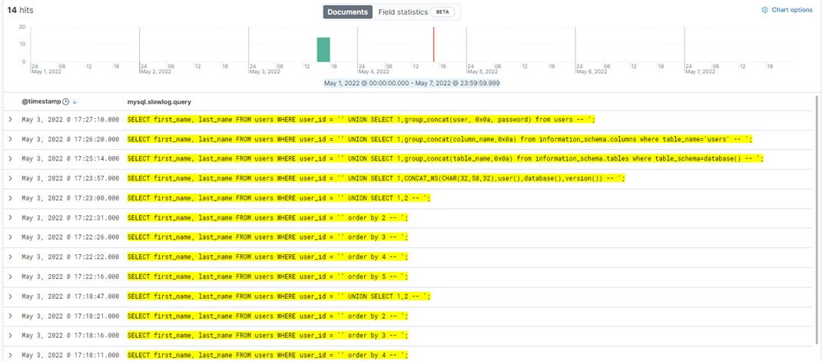
Elasticsearch continued

Slide 16
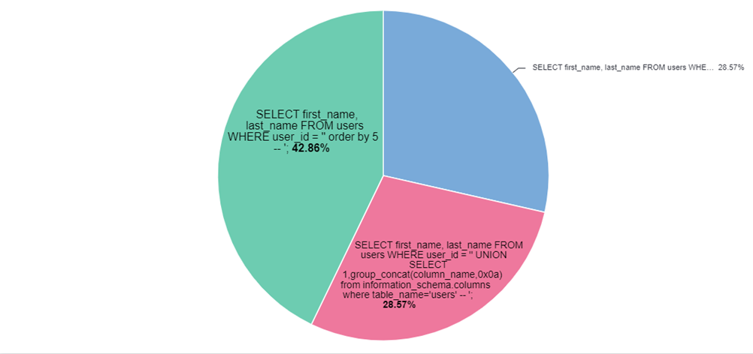
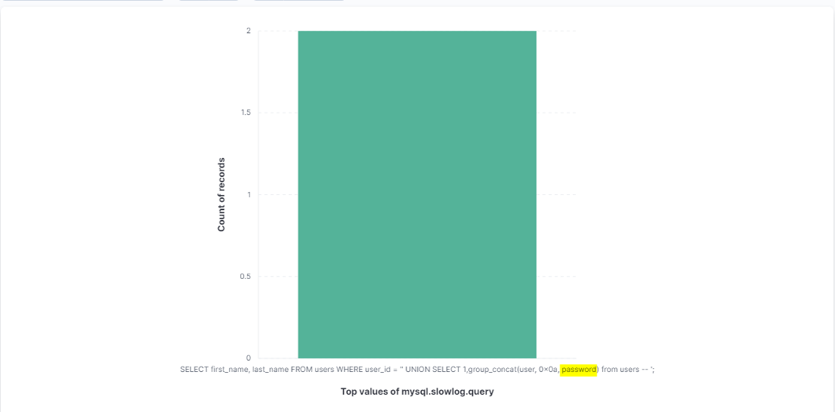
Elasticsearch continued
A pie chart of typical SQL commands that would be considered malicious due to certain words that are included in the entry (e.g. ORDER BY, UNION SELECT).
Shows a specific SQL command that contains a UNION SELECT with the term ”password“. This should be a clear indication of SQL injection since confidential information such as passwords are attempting to be accessed.

Slide 17
What we learned
Enhanced our knowledge of database security
Analytical research through the Cloud
Collaborative Development

Slide 18
Obstacles we faced
Having filebeat connect to Elasticsearch
Identifying the logs with visualizations
Hacking with the different SQL Injections

Slide 19
Future
Using OWASP
Looking for preventative ways for SQL Injections
Introducing more features of IDS
Automize processes

Slide 20
References
https://www.appknox.com/blog/sql-injection-attacks
https://owasp.org/www-project-top-ten/
https://www.malwarebytes.com/sql-injection
https://www.researchgate.net/publication/324227697_SQL_Injection_The_Longest_Running_Sequel_in_Programming_History
https://beaglesecurity.com/blog/vulnerability/time-based-blind-sql-injection.html

Slide 21

Thank you

